Slide 1



7th ACQF Continental Forum
28 July 2026

Slide 2
01
Agenda overview

Slide 3

Agenda
1 What is the QCP?
2 Interoperability in action
3 Why is the QCP important?
4 Current status & future plans
SESSION 1 · NOW
High-level overview & interactive showcase
SESSION 2 · TOMORROW
Trailblazer panel & live Q&A

Slide 4
02
What is QCP?

Slide 5

Join the slido for a quick poll!
Scan the QR
Alternatively: slide.com and enter the code: 4204713
#4204713

Slide 6
Do not edit
How to change the design
(EN) Have you ever heard about or consulted the ACQF Qualifications and Credentials Platform? (FR) Aviez-vous déjà entendu parler de la QCP ou l’avez-vous déjà utilisée ? (PT) Já tinha ouvido falar da QCP ou já a utilizou?
The Slido app must be installed on every computer you’re presenting from

Slide 7
The policy challenge the QCP responds to
◱
↔
◎
Fragmented data
Limited cross-border recognition
Low visibility
Paper, PDF and spreadsheet records are still common. Qualifications data is scattered and hard to compare and extract insights from.
No shared language or standard between systems, so recognising a foreign qualification might be slow.
Qualifications are often invisible to students, employers and the public: and where interfaces exist, they are limited.
The QCP is the continental response to all three: a single trusted, authoritative source of information on qualifications across Africa.
7th ACQF Continental Forum · QCP · Session 1

Slide 8
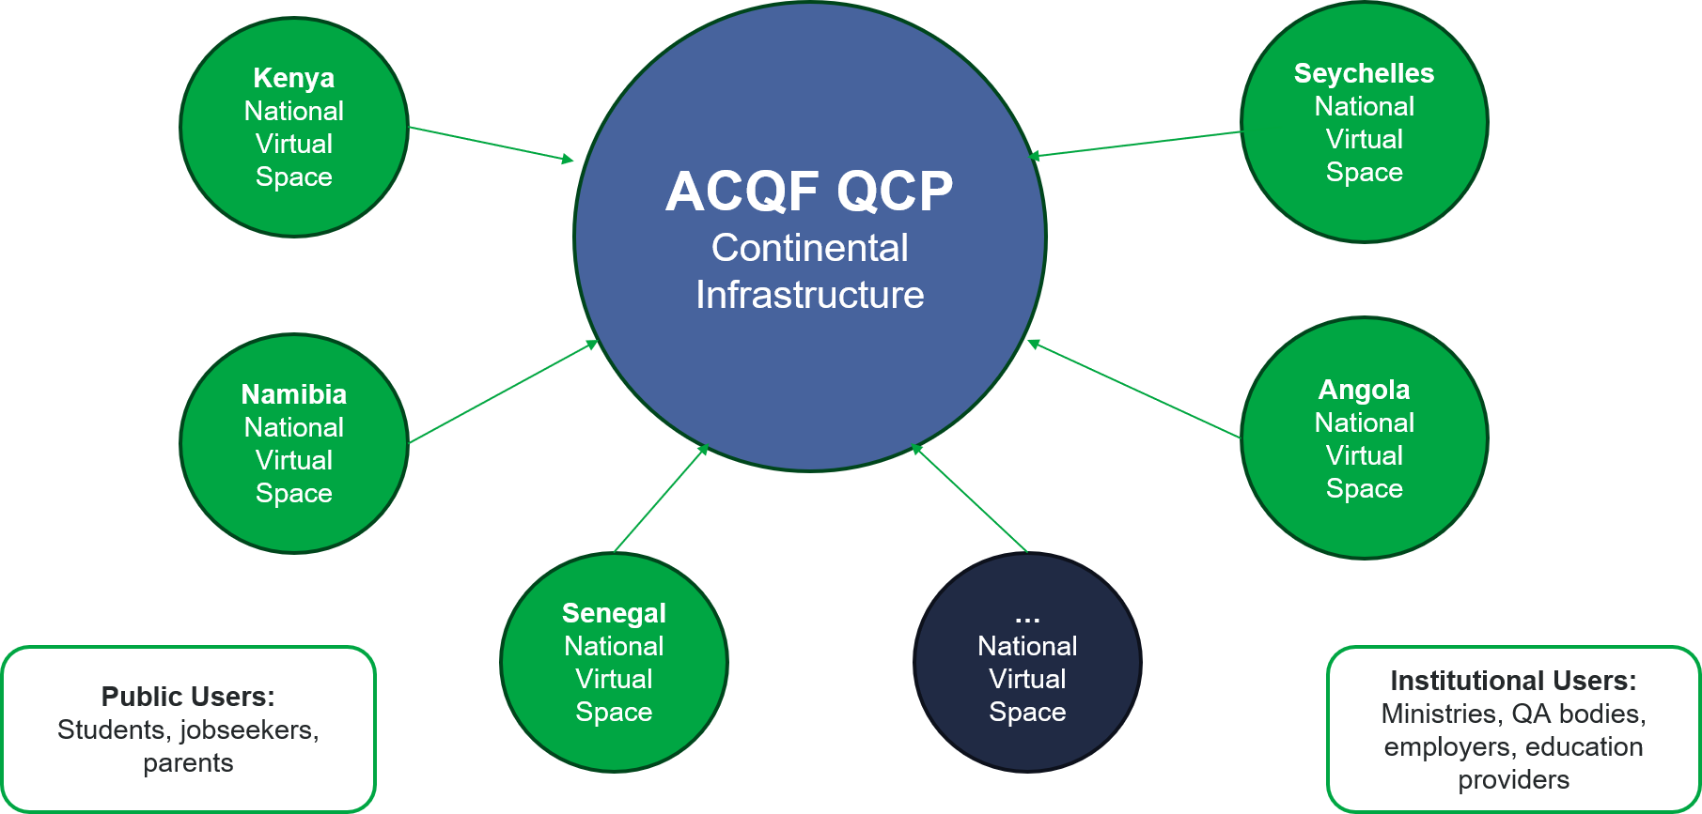
The QCP: an interoperable, open data platform
◆
Built on standards
The QCP Data Model and the global data standards it applies make records comparable across systems.
◈
Decentralised by design
Each country holds its own national virtual space and keeps full control of its own data.
●
Open data for everyone
Serves institutional users: ministries, QA bodies, employers as well as public users: students, jobseekers, parents.
7th ACQF Continental Forum · QCP · Session 1

Slide 9
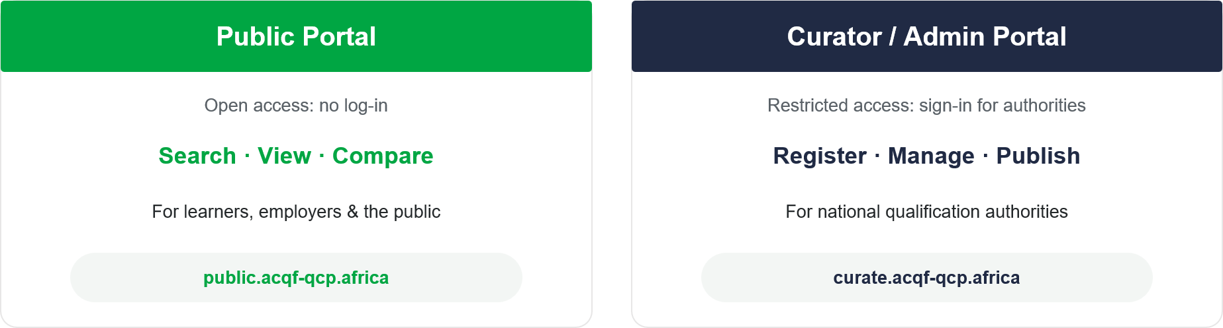
The QCP is live: one platform, two portals
Learning materials: self-paced online course · training modules · past webinars acqf.africa/qualifications-platform
7th ACQF Continental Forum · QCP · Session 1

Slide 10
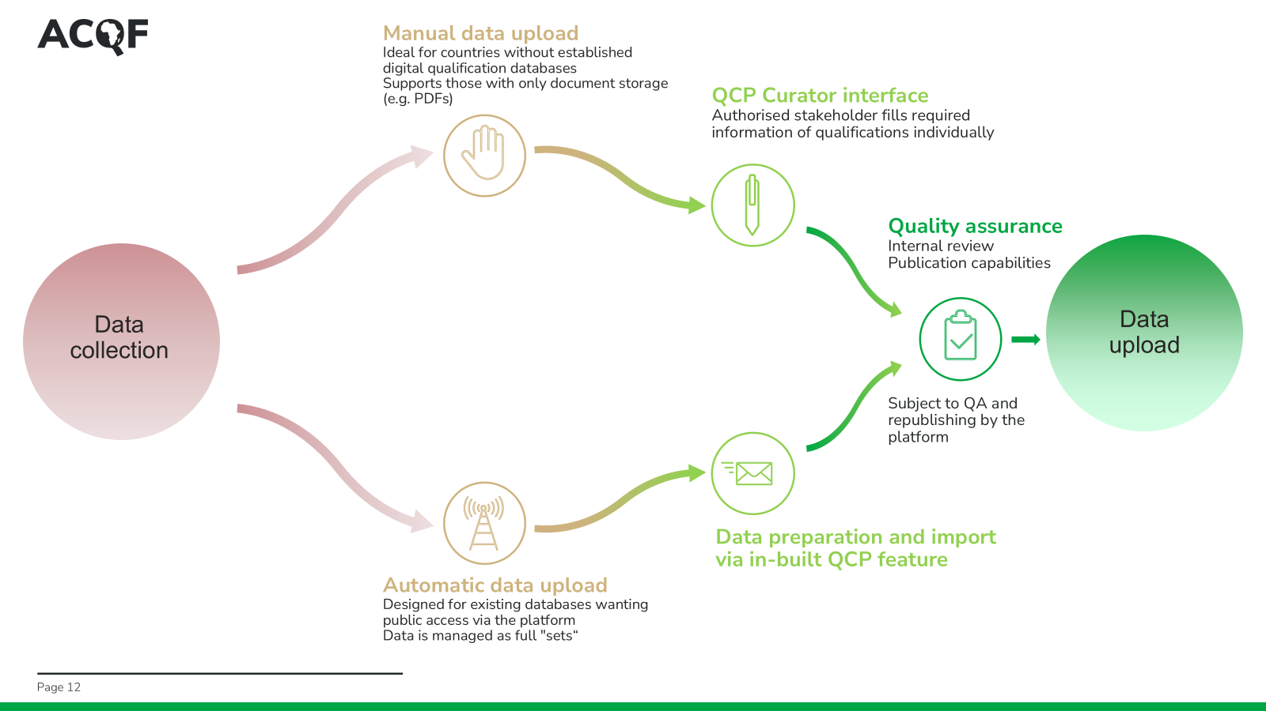

Slide 11
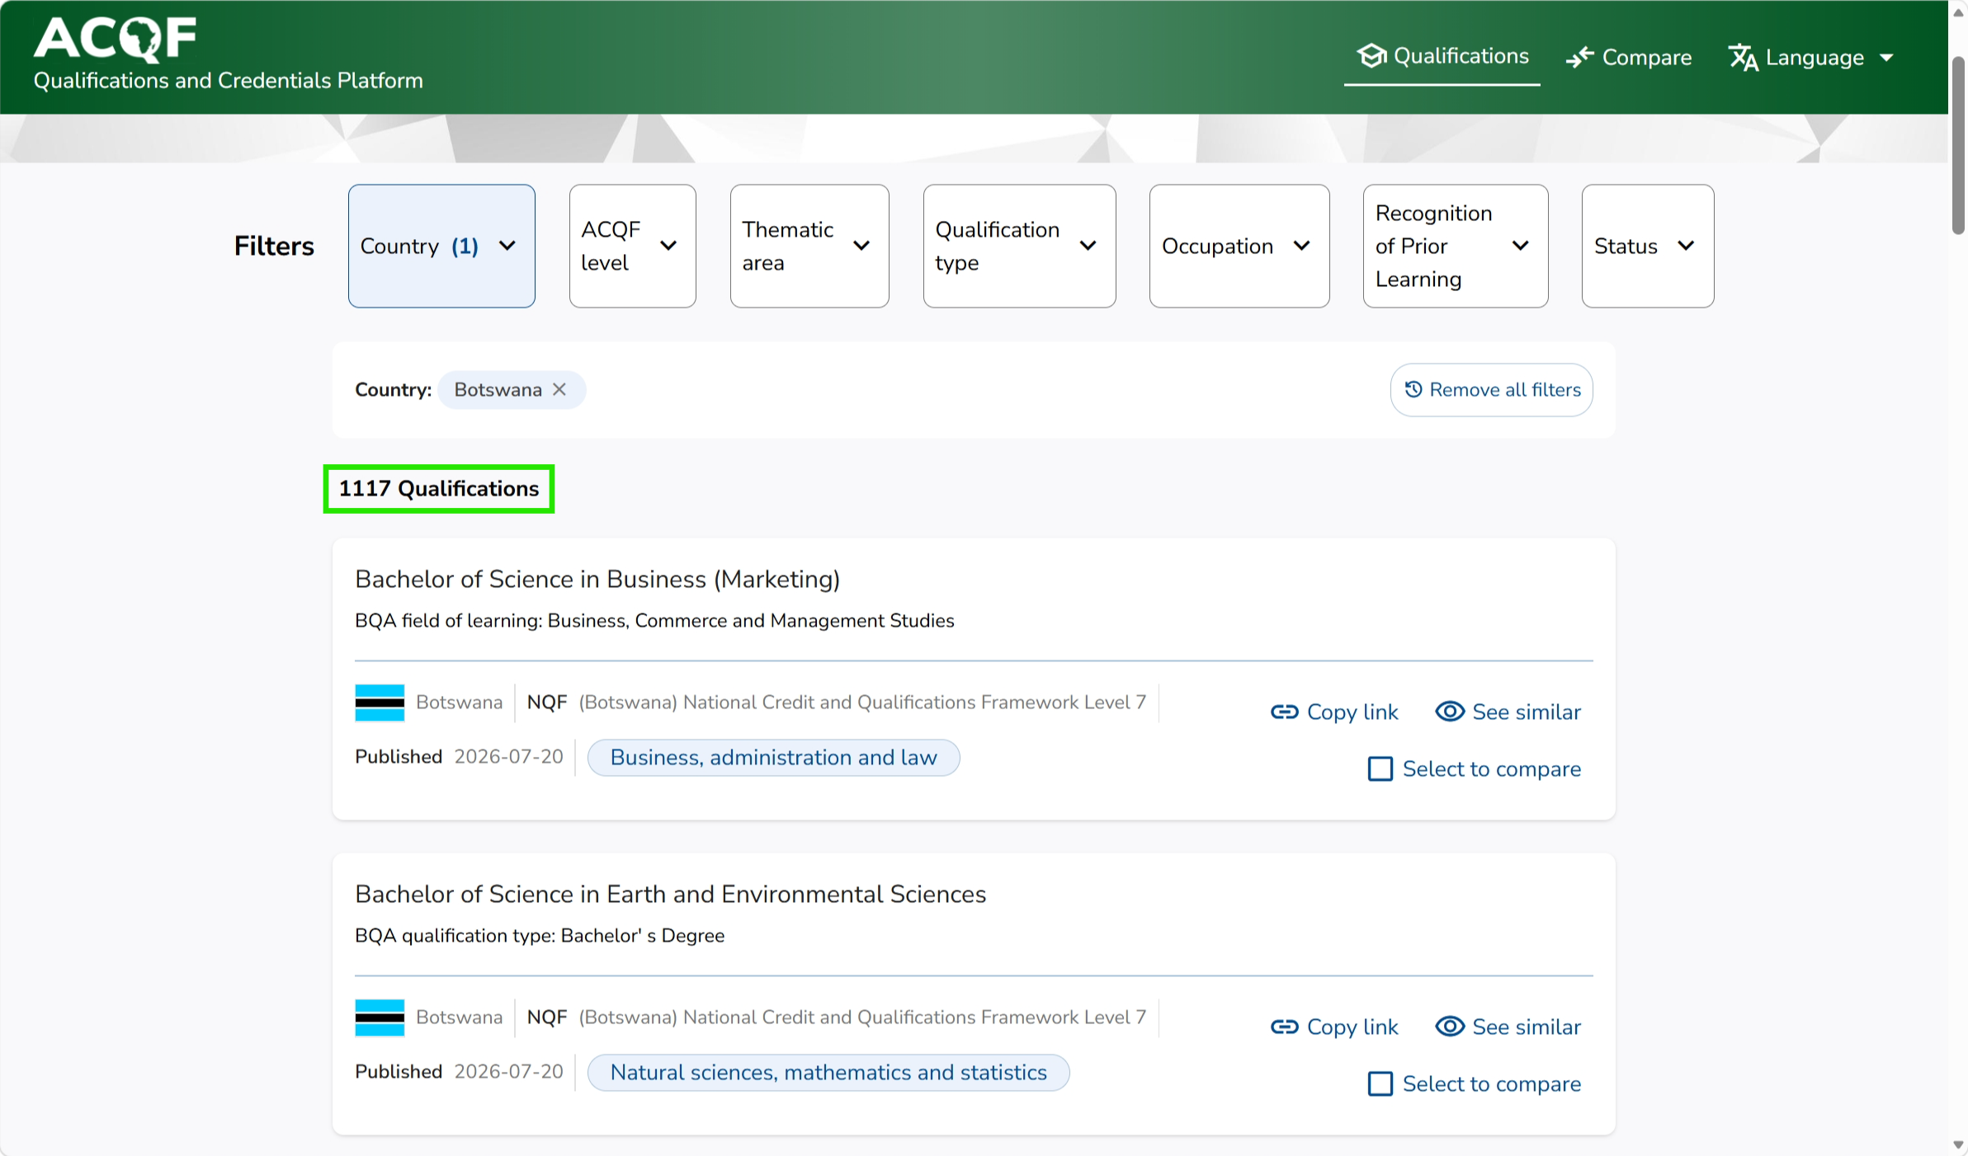
Automatic data upload - Botswana
Botswana is the first country to successfully utilise the automatic upload – publishing over 1000 qualification through machine transformation from their national database directly to the QCP.
(Currently only available in staging environment)

Slide 12
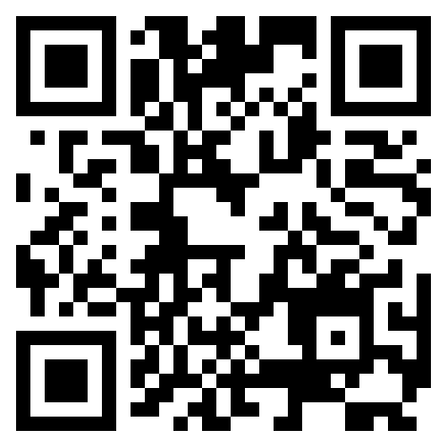
Open the public portal and try it yourself
The public portal is open access: no log-in needed.
Grab your phone and explore.
As you use the platform, ask:
What filters can be used?
What qualification details are visible?
How are individual country ownership and QA visible?
You can leave any observations from your experience in the conference chat or discuss with the team in person.
https://public.acqf-qcp.africa/

Slide 13
03
Interoperability in action

Slide 14
Why interoperability matters
Interoperability simply means that qualifications from different countries can be read, understood and compared together, while every country retain sovereignty of own system. In practice, that unlocks four things:
1
Recognition made easier
A qualification earned in one country can be understood and recognised in another — the basis for fair, faster recognition decisions.
2
Mobility for people
Learners and workers can move across borders knowing their qualifications will be understood wherever they go.
3
Trust and transparency
Reliable, comparable information gives employers, institutions and the public confidence in what a qualification really means.
4
Every country keeps its own system
Countries share one common language for qualifications while keeping their own national frameworks intact.

Slide 15
What interoperability delivers in practice
The platform is built to international standards, the same ones used across Europe and beyond, so African qualifications data fits naturally into the wider world.
✓
One common way to describe qualifications
✓
Data that stays up to date on its own
Every country describes its qualifications in the same agreed way, based on international standards, so information from different countries fits together and can be compared.
A qualification recorded once at national level flows automatically to the continental platform, so everyone sees consistent, current information.
✓
No need to reinvent the wheel
✓
Only trusted data is published
Africa reuses proven international approaches rather than building from scratch, saving years of work and significant cost.
Information and its authenticity is checked before it appears, so users can rely on what they see on the platform.

Slide 16
One shared language under the hood
Interoperability is not a feature bolted on — it is the standards the platform is built on. Each one lets QCP data connect to something bigger.
ISCED-F
ISCO
ESCO
ACQF / RQF / NQF
Fields of study
Occupations
Skills & competences
Levels
Comparable subject areas across countries
Links qualifications to the labour market
A shared skills vocabulary for matching
Ten-level translation device between systems
Because the QCP speaks these standards, a qualification described once can be compared, matched and referenced far beyond the platform.
7th ACQF Continental Forum · QCP · Session 1

Slide 17
How the platform compares qualifications
•
Side by side
94%
Two qualifications shown field by field, so differences are clear at a glance.
•
Related qualifications
The platform automatically suggests similar qualifications worth comparing.
of surveyed institutional stakeholders named comparison the feature they would most use.
•
Filter and narrow
Narrow by country, level, sector and type to find the right qualifications to compare.
QCP Baseline analysis questionnaire
A shared level reference
•
A common framework of levels (e.g. ISCED-F) acts as the translator that makes qualifications comparable across countries.
Accurate comparison depends on structured data
Each qualification is held as organised information, field by field, so like is compared with like. Comparing whole documents or PDFs side by side simply cannot deliver the same accuracy.

Slide 18
Your turn: compare qualifications
On public.acqf-qcp.africa,
select a qualification, open it and then head to either See Similar or Compare buttons and search for another one you’d like to compare it to.
alternative route: on listing choose the Select to compare in the bottom right ⁝ menu on two qualifications, and read them field by field.
https://public.acqf-qcp.africa/
Tip: Use the “See similar” feature to find a comparable qualification

Slide 19
One language, two continents
Europe already runs a platform, the Qualifications Dataset Register (QDR), that brings together qualifications from its 21 countries. Because the ACQF platform follows aligned international standards with European uses, the two can connect and understand each other.
ACQF-QCP
Shared international standards
European QDR
Africa
a common language
Europe · Europass
What it unlocks
A qualification from Europe can be discovered, understood and compared in Africa — and the other way round
The foundation for mutual recognition and for the mobility of learners and workers between the continents
Reuse of proven methodologies — compressing what took Europe around ten years into two to five years for Africa

Slide 20
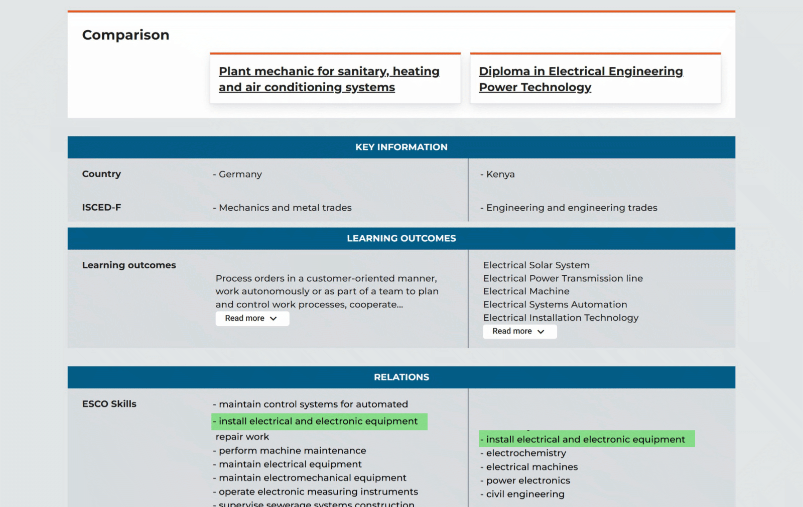
One language, two continents

Slide 21
04
Why is QCP important?

Slide 22
The value case: enriched data unlocks new uses
The QCP's long-term value is exponential: the more qualifications are registered and the more detailed their descriptions are, the more insight you can gain. The subsequent slides are a showcase of future potential functionalities of QCP.
What we ask countries to provide
What it unlocks
Basic qualification details
Classify qualifications against ISCED-F (fields of study)
Categorise occupational relevance using ISCO
Link learning outcomes to ESCO skills
Provide learning-opportunity data
Learner tools: skills profiles, learning & job matching
National statistics: portfolio, coverage, blindspots
Continental comparison and future-skills planning
7th ACQF Continental Forum · QCP · Session 1

Slide 23
What it unlocks for citizens on the long-term: the Learner View
A single learner journey: from understanding your skills, to finding learning, to seeing where you can work.
1
2
3
Skill profiler
Learning-opportunity matching
Job & occupation matching
Upload a CV, diploma or micro-credential; or describe your experience. AI extracts skills against a common taxonomy (ESCO).
Courses are matched to the gaps in your profile, showing which skills you would gain or upskill.
Roles are ranked by a match score (e,g, apply, upskill or retrain) linking qualifications to the labour market.
Note: the QCP need not be the only public portal providing this function: national career portals, employer platforms and counsellor tools can all build on the same QCP data.
7th ACQF Continental Forum · QCP · Session 1

Slide 24
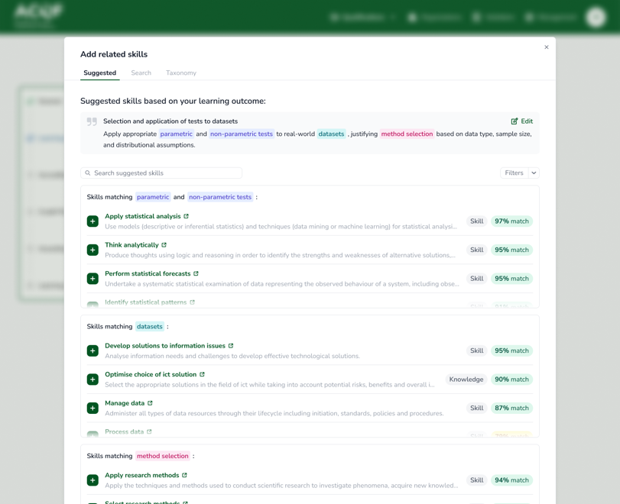
For authorities: ESCO referencing
•The NQA staff writes its learning outcome in natural language: as it would regularly
•The platform runs a semantic search in the background and suggests candidate ESCO skills with a match score and type (skill / knowledge / transversal).
•The authority's role becomes review and approval: not manual search of the ESCO database.
•This reframes referencing from a compliance task into an assisted one: one of the most direct levers for accelerating ESCO coverage across the QCP.
7th ACQF Continental Forum · QCP · Session 1

Slide 25
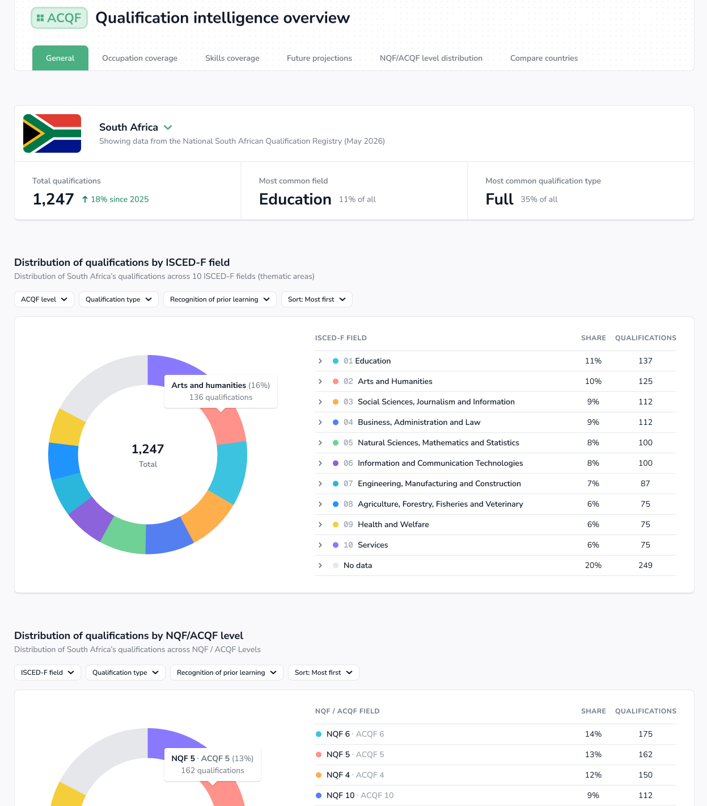
What does it add for professionals?
Skills & Career Intelligence: national view
Easy and in-depth answer to a question such as: what is in our qualifications portfolio?
Distribution by ISCED-F field, NQF/ACQF level, qualification type and recognition of prior learning
Interactive, filterable dashboards: a structured reflection on the national landscape
Every view is driven by the metadata countries provide; it degrades when that data is missing
7th ACQF Continental Forum · QCP · Session 1

Slide 26
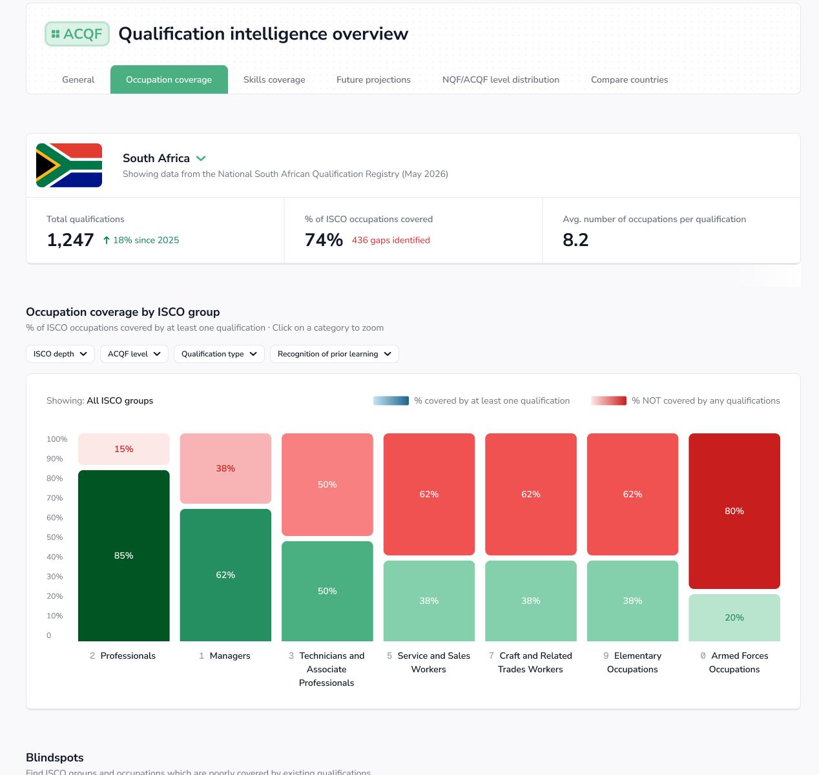
Skills & Career Intelligence - continued
Occupation coverage runs qualifications against ISCO occupations: where the labour market is covered, and where it is not.
The Blindspots table names the occupational sub-groups for which no current qualification exists.
It is intended to be the single most policy-actionable artefact in the dashboard — a direct input to where new qualifications are needed.
The same logic runs for skills coverage against ESCO, plus digital- and green-skills penetration.
7th ACQF Continental Forum · QCP · Session 1

Slide 27
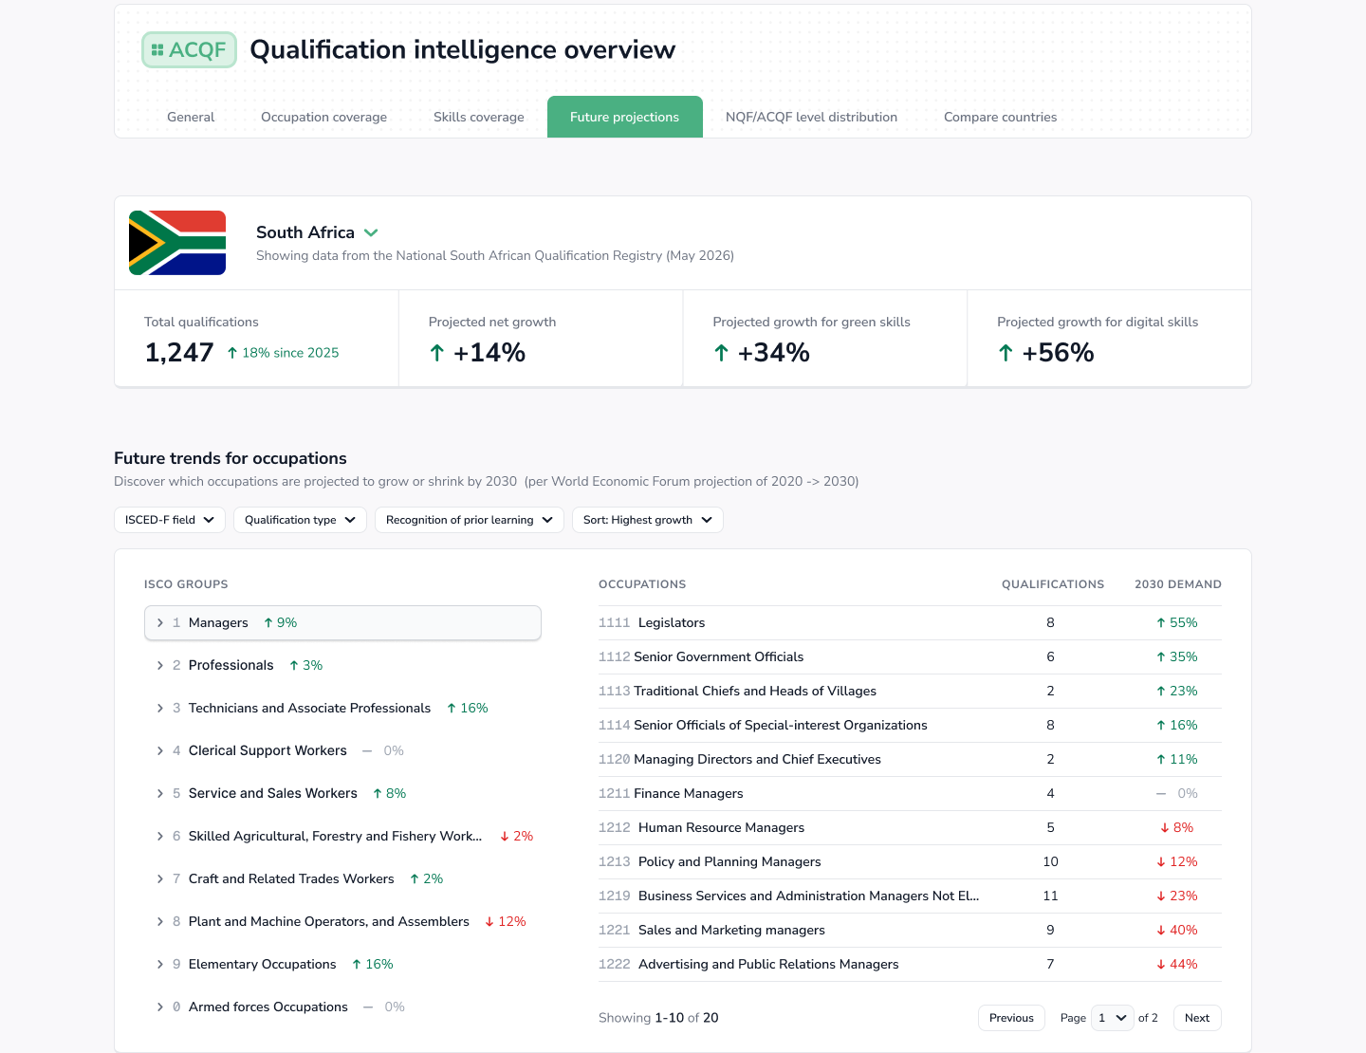
Skills & Career Intelligence - continued
Continental comparison lets a country see itself in context: qualification counts by country and across ISCED-F fields.
It surfaces where regional cooperation on a curriculum or qualification is warranted because supply is thin across several countries at once.
Future projections (e.g. on skills and occupation demands) can be used and cross-referenced with data on qualifications
This is where the QCP becomes a planning tool: which sectors are underprepared for future demand?
7th ACQF Continental Forum · QCP · Session 1

Slide 28
Don’t forget: QCP is yours to use! :)
S
Search
Look up a qualification and see its level, field and description.
C
Compare
Put two qualifications side by side across countries.
E
Explore
Check the qualifications of other countries’ and its details
Q
Questions or access issues
Would you like to discuss during the conference?
Please contact us at: support@acqf-qcp.africa
https://public.acqf-qcp.africa/
7th ACQF Continental Forum · QCP · Session 1

Slide 29
05
Current status and future plans

Slide 30

Where does QCP stand today?
Presented by Haron Chege, Chair, QCP Cluster (Cluster 2)
24
20
518
109
countries engaged
national virtual spaces
qualifications uploaded
published & public
Uploaded by 13 countries · published by 5
Page 23
7th ACQF Continental Forum · QCP · Session 1

Slide 31
Recognising the trailblazers
Five countries are carrying the platform forward with sustained, active data contribution.
Kenya
South Africa
Zambia
Seychelles
Mauritius
32
82
35
12
6
uploaded
uploaded
uploaded
uploaded
uploaded
22
51
26
4
6
published
published
published
published
published
These five account for the majority of qualifications published continentally proof that sustained engagement, not platform size, is what moves data from uploaded to public.
Page 24
7th ACQF Continental Forum · QCP · Session 1

Slide 32
Beyond the trailblazers: where everyone stands
24 countries, four clusters of engagement.
5
Actively publishing
Kenya, South Africa, Zambia, Mauritius, Seychelles
7
Engaged & preparing
Angola, Botswana, Cabo Verde, Lesotho, Namibia, Senegal, Zimbabwe
4
Early stage
DRC, Eswatini, Malawi, Morocco
8
Not yet engaged
Djibouti, Ghana, Guinea Bissau, Mozambique, Sierra Leone, Somalia, South Sudan, Tunisia
Page 25
7th ACQF Continental Forum · QCP · Session 1

Slide 33




What's standing in the way
The same handful of blockers recur across the continent and none of them are about the platform itself.
Unstructured data
National systems in flux
Institutional fragmentation
Competing priorities
Qualifications sitting in Word, Excel or PDF rather than a database.
New national databases being built delay QCP integration until they stabilise.
No single NQF authority yet — data split across ministries or agencies.
Automated data exchange sometimes ranks below other pressing institutional work.
Page 26
7th ACQF Continental Forum · QCP · Session 1

Slide 34


Looking ahead: the Cluster's mandate
Three pillars that frame everything the QCP Cluster does from here.
Coordination
Adoption
Sustainability
Steer and support QCP implementation at national and continental level; nurture the platform's tools and technical practice.
Grow country participation, data quality and policy integration the work that unlocks most of the platform's value.
Work with Cluster 5 (Financing) and Cluster 4 (Communication) so the platform is politically and financially anchored beyond ACQF-II.
Page 27
7th ACQF Continental Forum · QCP · Session 1

Slide 35


Continuity is secured
The bridge to a longer-term governance decision — not the destination.
ETF hosting through 2027
A deliberate bridge to keep the platform live Anatolii, Zalan and Honza have spoken to it.
The QCP Cluster steps up
Taking on capacity development, country support, and governance of any modifications needed to the platform.
The real question: who owns this next?
Four pathways are on the table from 2028 — from continued AU-EU hybrid governance to full AU institutionalisation. This is for AU-EU political deliberation, not a technical prescription — but it's the decision that matters most.
Page 28
7th ACQF Continental Forum · QCP · Session 1

Slide 36

What we're asking of you
Three concrete steps any national authority can take starting now.
Contribute data, become an exemplar
Name your national champions
Use the QCP where infrastructure isn't ready
Add qualifications data and join the countries whose visible effort is carrying the platform forward.
Across qualifications authorities, education and labour ministries, statistics offices, and HEI registrars.
Virtual spaces can serve as a quasi-national qualifications database — at no infrastructure cost.
Page 30
7th ACQF Continental Forum · QCP · Session 1

Slide 37

Live infrastructure. Real momentum.
A clear ask to national authorities. A secured bridge to 2028.
Over to you: what's the one thing your institution needs to move further with the QCP?

Slide 38
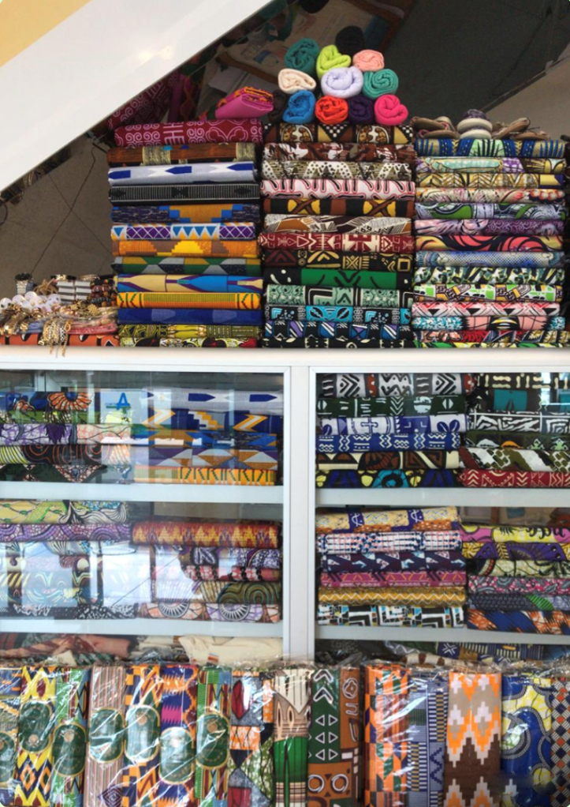
Thank you
Obrigado
Merci
With any questions, feel free to reach out to:
support@acqf-qcp.africa
Credit: Eduarda Castel Branco

